Slide 1
United States Breweries and Beer
Varun Gopal and Roslyn Smith
February 22, 2022

Slide 2
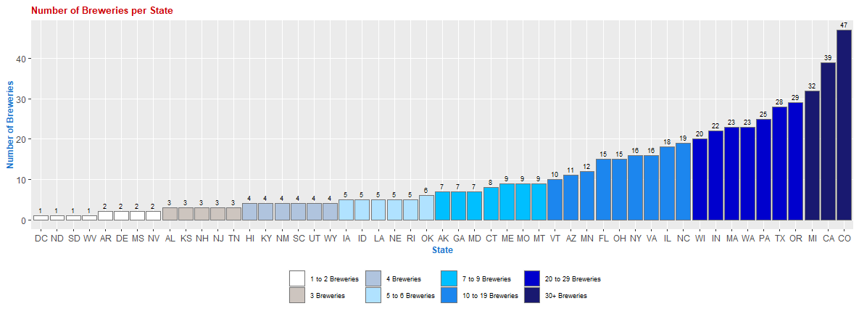
Breweries in the United States by State There is at least 1 brewery in each state in the United States. Colorado, California and Michigan lead with more than 30 breweries each. 50% of the states have 7 or less breweries with only 20% of the states have 20 or greater breweries.
Question 1 Version 1

Slide 3
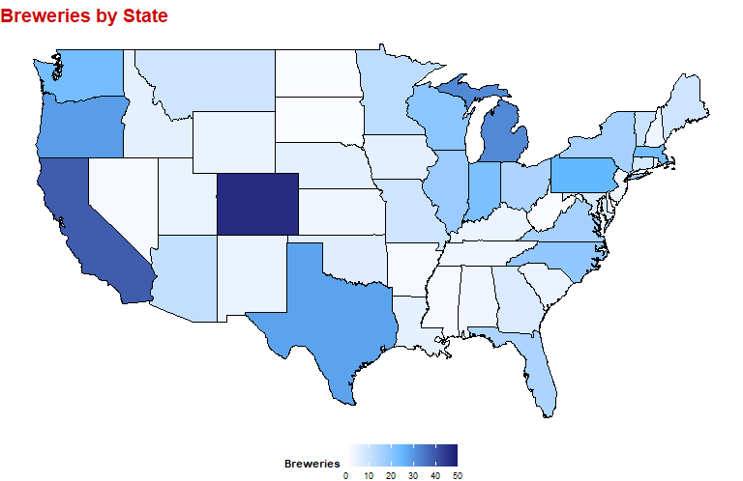
Breweries in the United States by State
Question 1 Version 2
There is at least 1 brewery in each state in the United States. Colorado, California and Michigan lead with more than 30 breweries each. 50% of the states have 7 or less breweries with only 20% of the states have 20 or greater breweries.

Slide 4
Alcohol by Volume (ABV) and International Bitterness Unit (IBU) In the data provided, 3% (62) of the beers did not have an ABV rating and 42% (1,005)of the beers did not have an IBU rating. Those groups are excluded from subsequent analyses and the final population that is being evaluated is 1,405 beers with all data elements.
Question 2 / 3 Version 1
Placeholder

